Slide 1


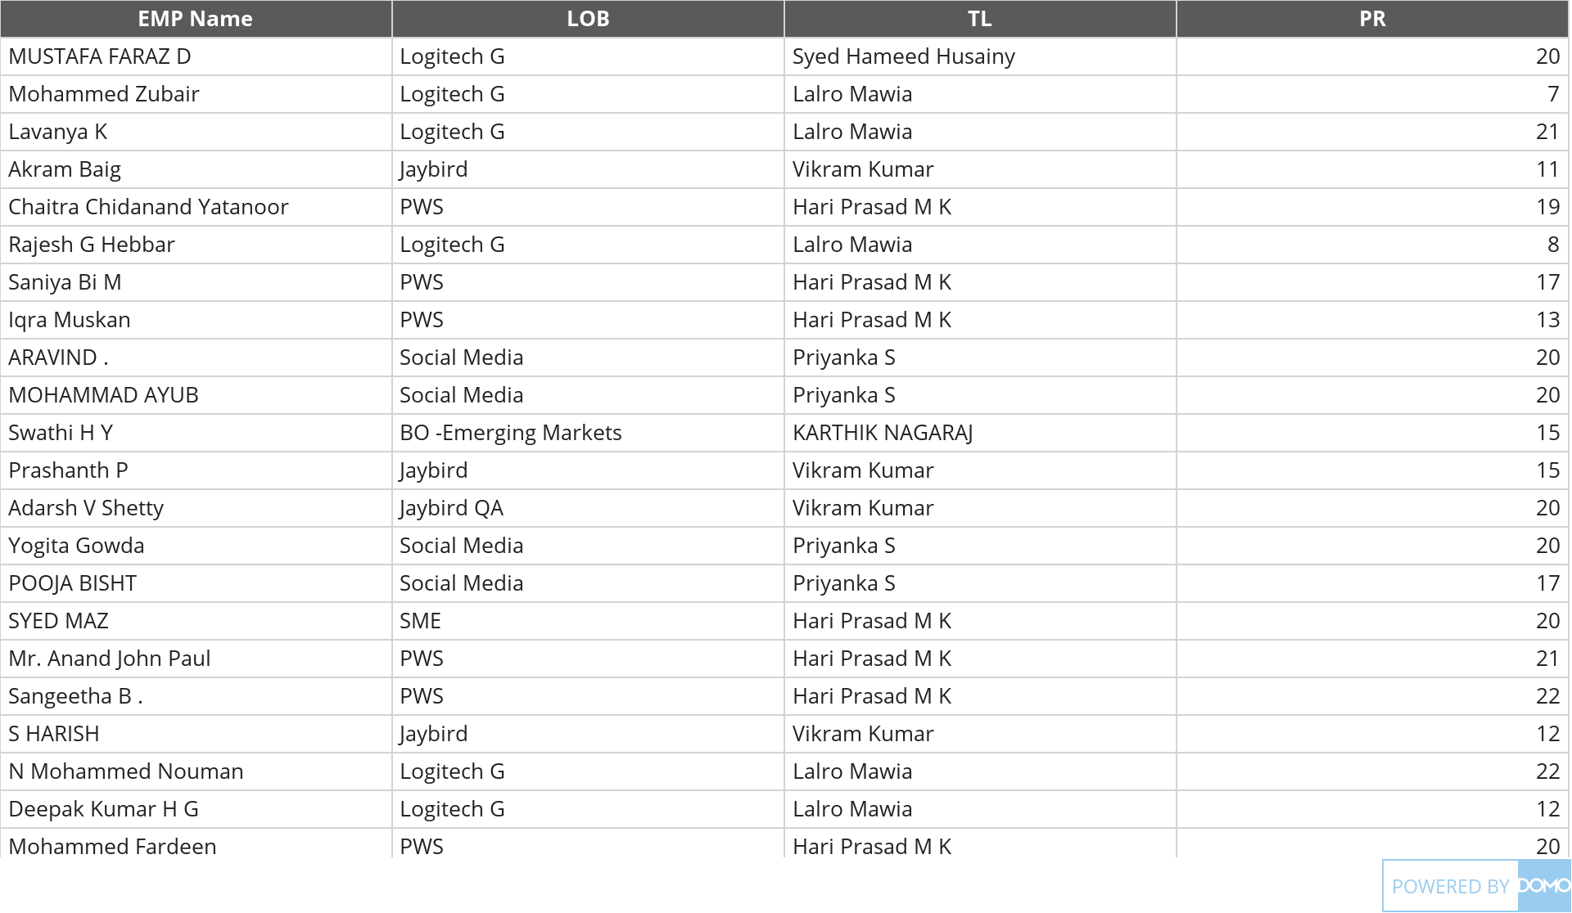
+
exported Apr 6, 2025, 12:54:00 AM MDT
Jan Attendance .xlsx
Jan 1, 2025 - Jan 31, 2025
3K Sum of PR

